Slide 1
Deleting/Hiding Folders in Roundcube by Dale Maguire
Notes:
From the Mail Screen, Click the ‘cog’ at the bottom of the Folder list

Slide 2
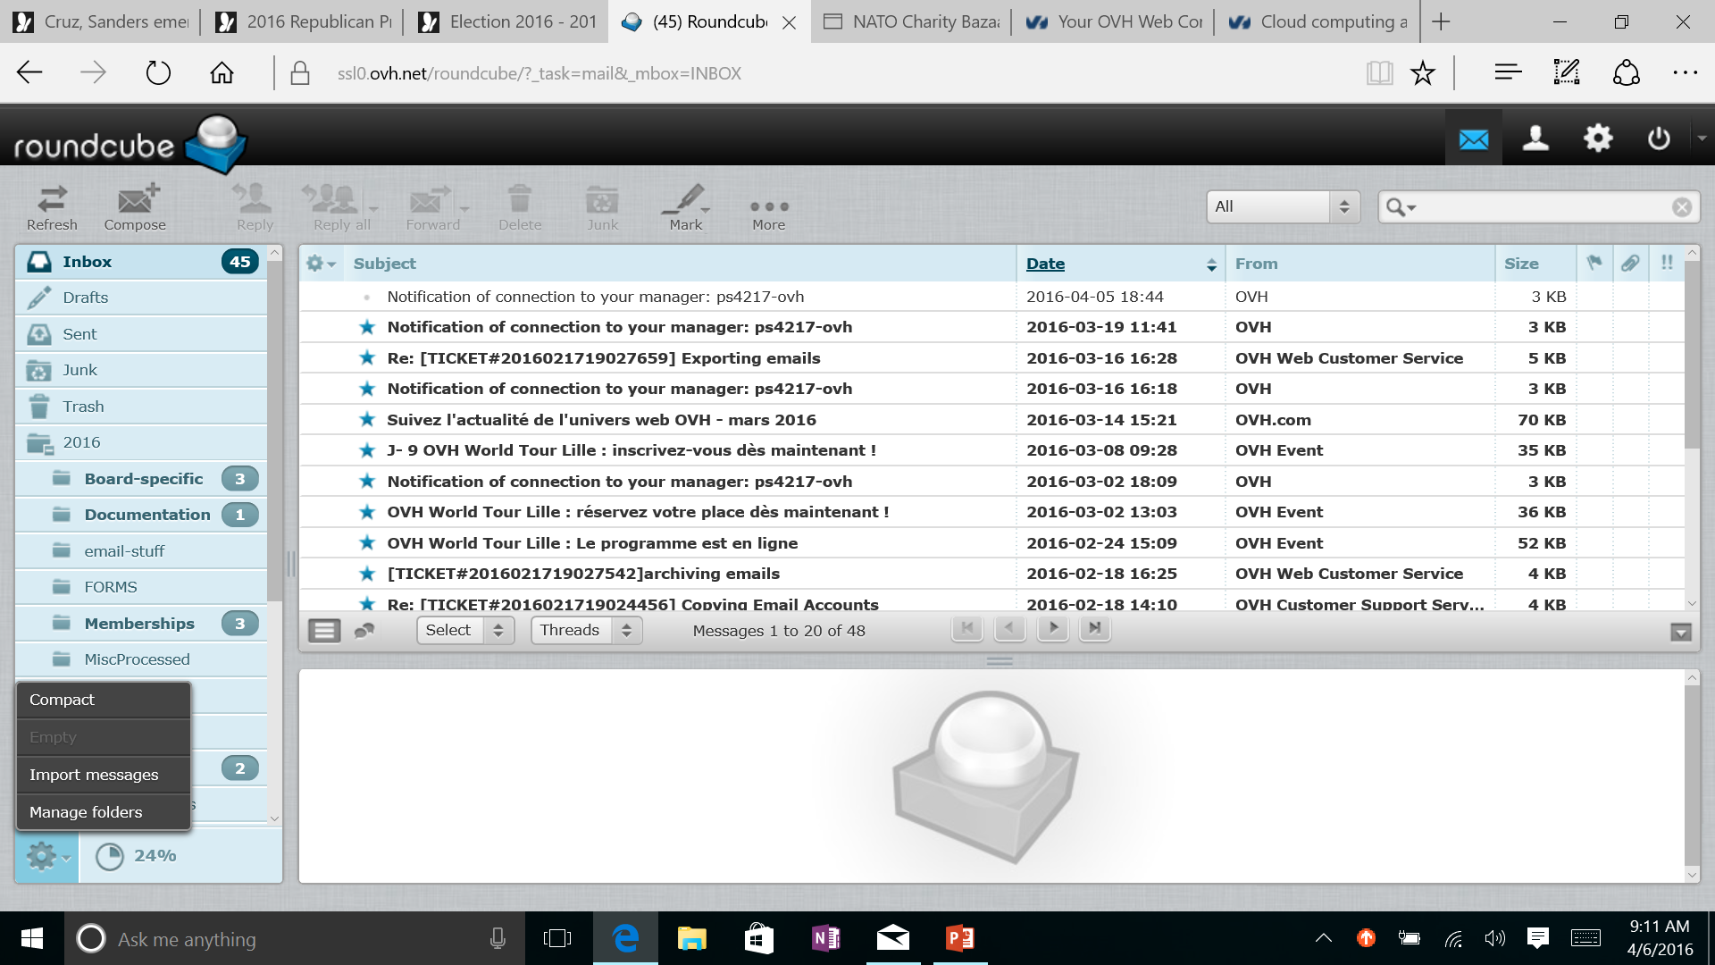
Click envelope(mail) icon on the command bar in the upper right Roundcube screen
Click the ‘cog’ (folder actions) icon at the bottom left of the Folders window
Select ‘Manage Folders’ from the drop-down menu
Notes:
‘Select Manage Folders’

Slide 3
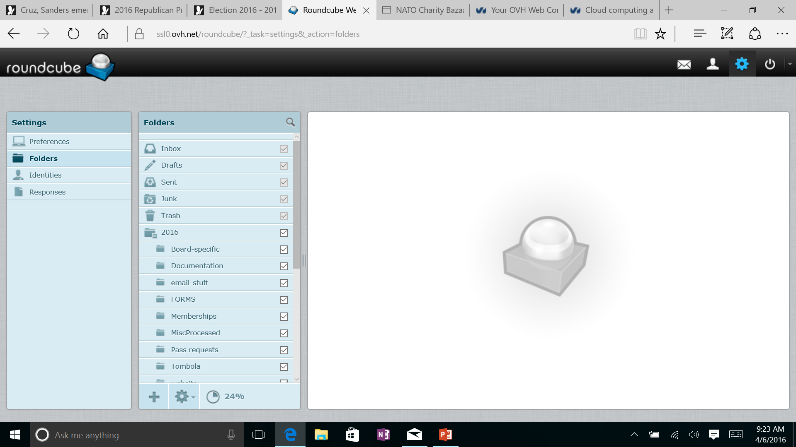
Select ‘Folders’ from the Settings Menu in the (left most) Folder management window
Scroll folder list for desired folder in the Folders (middle) Folder management window
Notes:
Select ‘Folders’ from the Settings Menu

Slide 4
Hiding a folder
Uncheck the box to the right of the desired folder found on the Folder list (see test folder in the example)
The folder will not appear on the list of folders when you select Mail
But the folder will still be available under ‘Manage’ if necessary

Slide 5
Deleting the Folder
1. Click on the desired folder to select it (see test folder in example)
2. Click on the ‘cog’ at the bottom of the Folders list
3. Select Delete from the drop-down menu
The folder will be permanently deleted from the Roundcube data base

