Slide 1
Detecting/Creating Email Spoofs in RoundCube by Dale Maguire 2016

Slide 2
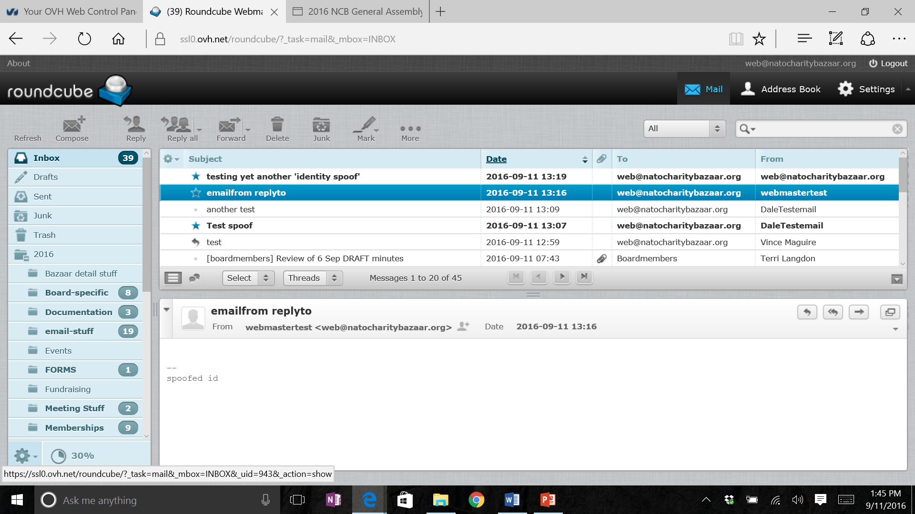
Detecting email spoofs (first glance)
Notes:
The ‘From’ field in email clients displays textual name input by a user.
First Glance- does this field follow Organization conventions?
This is NOT always a good check- Spoofers are good at duplicating this from information they might be able to glean from website and other sources

Slide 3
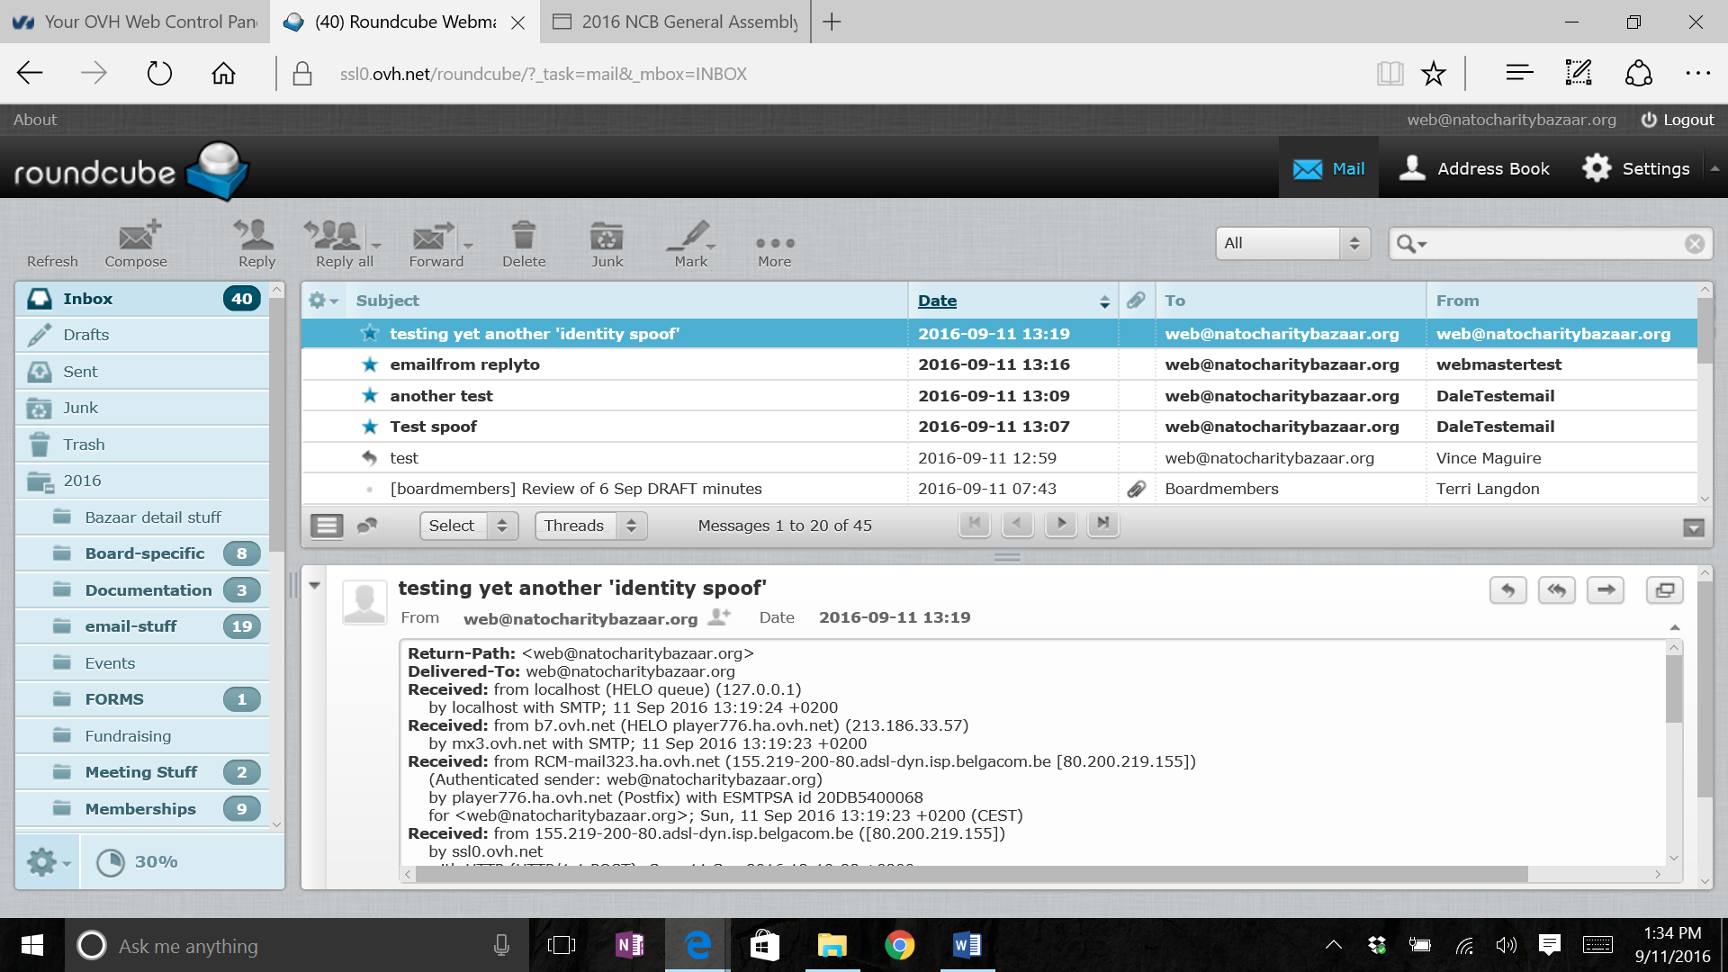
Detecting email spoofs (closer look)
Notes:
A close look at the email/message header can give other clues about the authenticity of an email ‘sender’
Still at first glance, this might appear genuine- but spoofers often can duplicate information to look authentic
Better to check more closely-
WHO is listed as the ‘AUTHENTICATED SENDER’, if available, does it match the Return path? Is it a valid address?

Slide 4
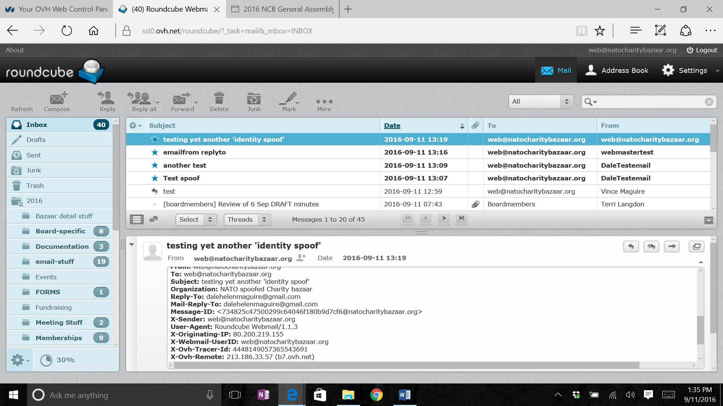
Detecting email spoofs (more details)
Notes:
Scrolling down further in the message header details note the REPLY TO/MAIL-REPLY-TO values. Do they match? Do they direct the email to a valid/recognizable email address?
Check also
the USER-AGENT, if available. Again, is this a recognizable email hosting system to your knowledge (it is suggested that you get to know these for regular email correspondences)
If available, check the WEBMAIL-USERID- is it valid and recognizable- generally spoofed emails will have unrecognizable values here

Slide 5
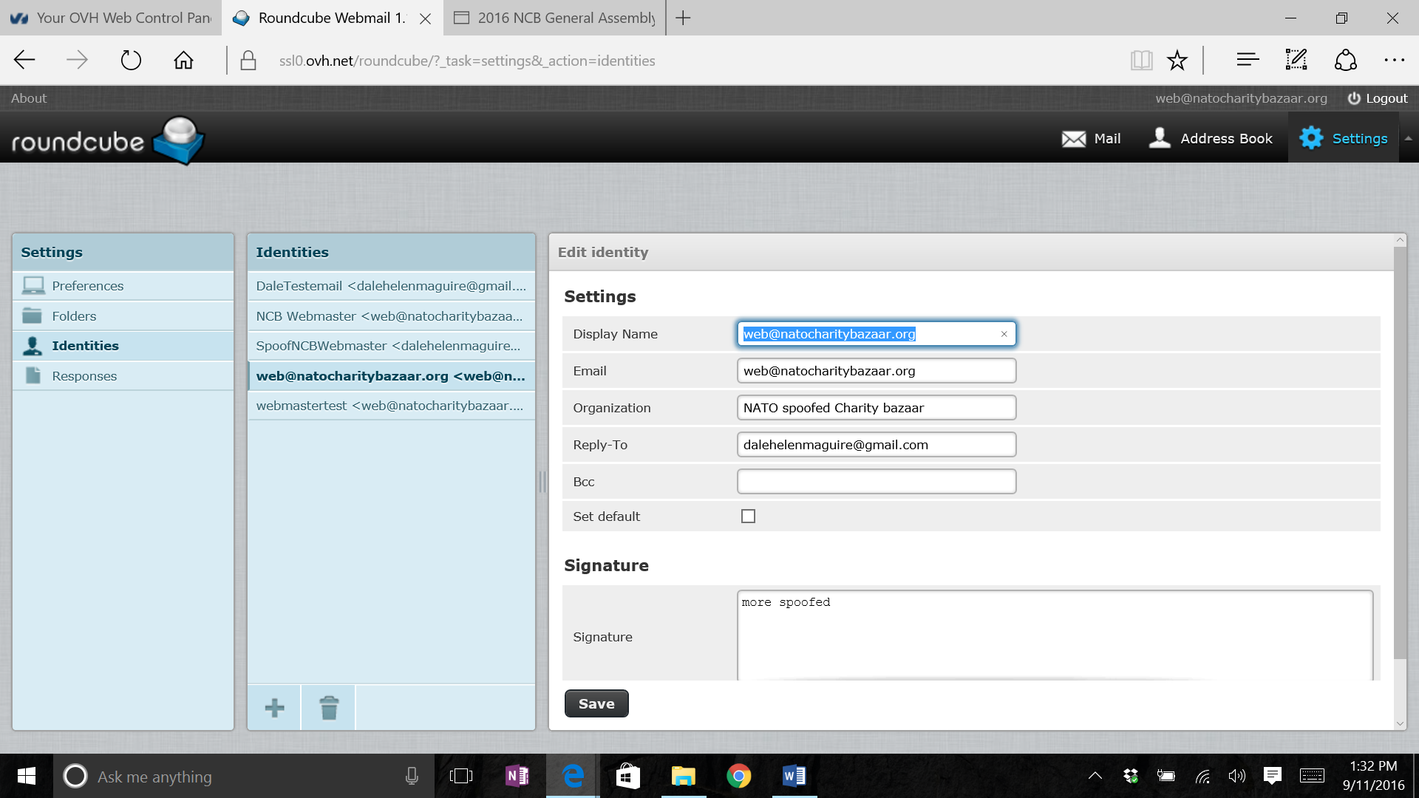
Spoofing Email (how its done)
Notes:
In our RoundCube system like others out there we can manipulate these email header fields.
Click settings
Select Identities
Select/’+’ from/to list
There is NO Error checking or Validation for the following fields so ANY value may be entered in each
Display name- will display in the ‘FROM’ field of any email client used (outlook, gmail, yahoo, RoundCube, etc..)
Email address- address that will be displayed as the RETURN PATH value in the message header
Reply-To- will be the ACTUAL address that email replies will be sent to (not eh RETURN PATH- but the MAIL-REPLY-TO field in the message header)

Slide 6
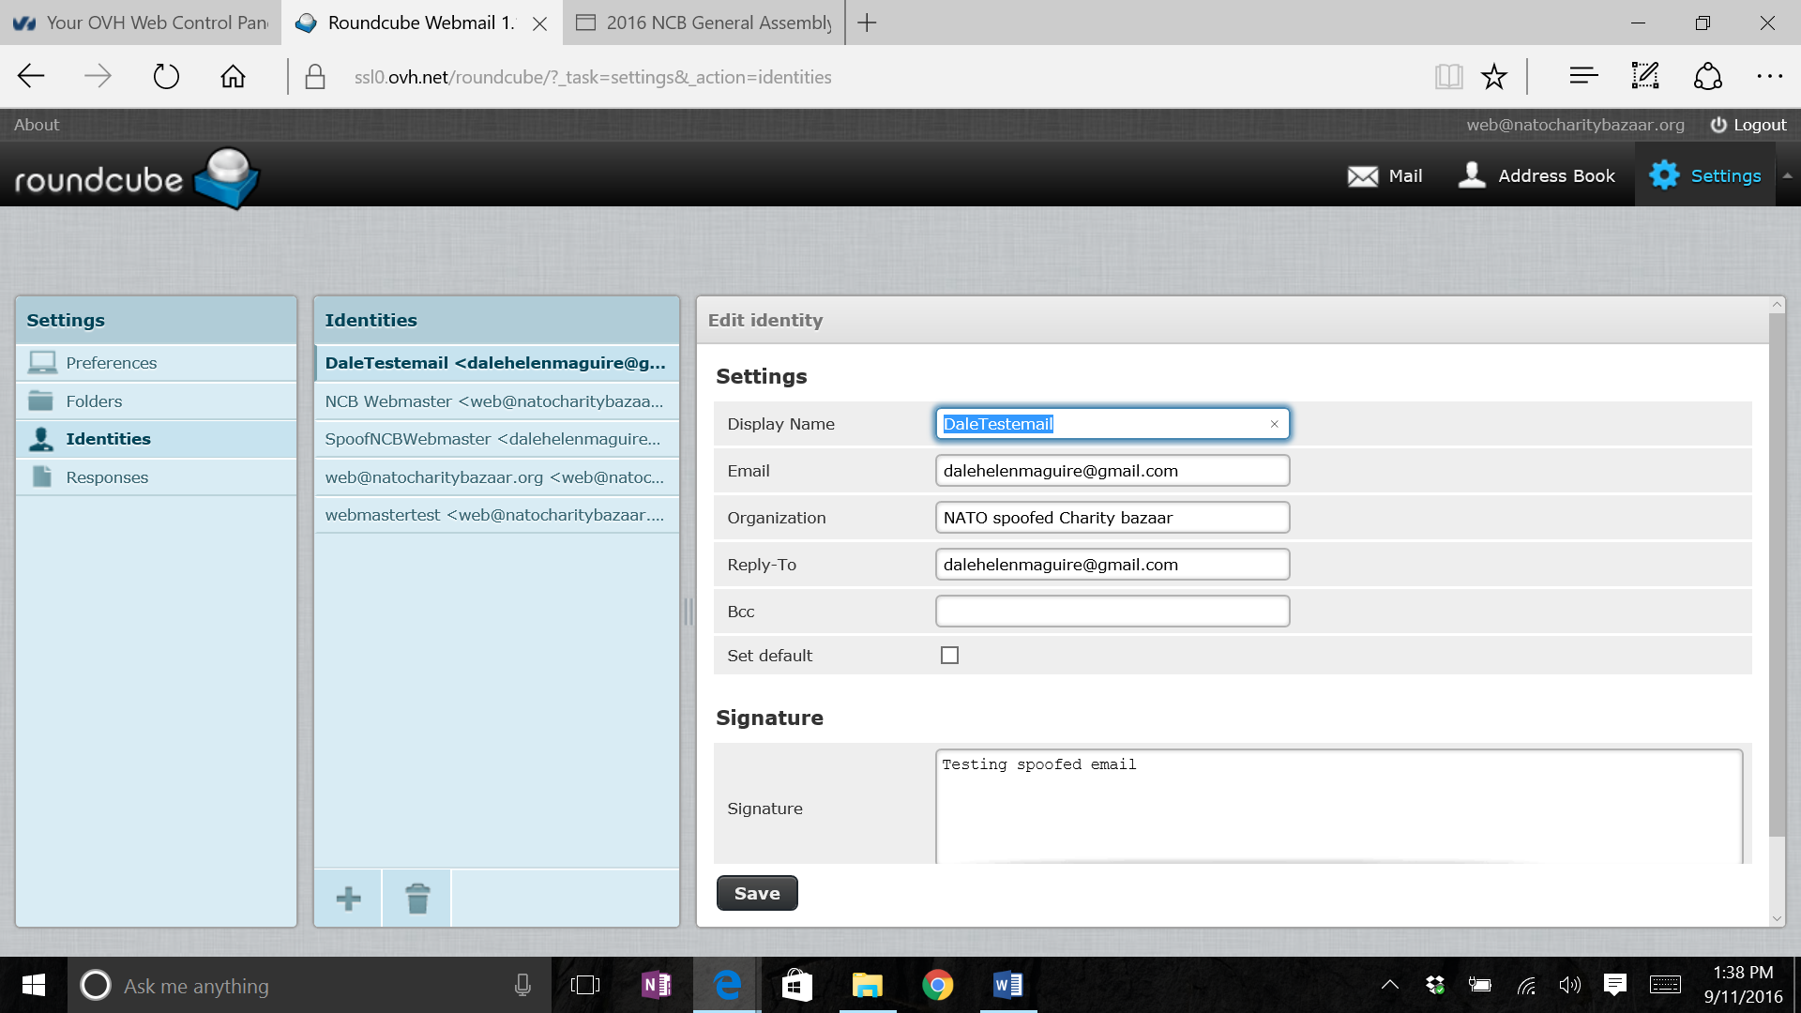
Spoofing Email (how its done- another example)
Notes:
See how the fields in the identity settings affect the message header values. Note that if a different email addres were entered in the Reply-to field this would direct any replies to the indicated address

Slide 7
Viewing Email Header
1
2
OR
Notes:
Ways to view the message header in RoundCube
From the email list screen
1. Click ‘More’ on command line of the email screen
2. Select ‘<> Show source’
the text file will display in a new window for you
OR from the message:
1. Click the down arrow/carrot on upper right corner of message, just below the email command icons
a small display window will pop up at the top of the message. You may need to scroll through the window to find information you need

Slide 8
Viewing Email Header (full-text)
Return-Path: <dalehelenmaguire@gmail.com> Delivered-To: web@natocharitybazaar.org Received: from localhost (HELO queue) (127.0.0.1) by localhost with SMTP; 11 Sep 2016 13:09:22 +0200 Received: from b7.ovh.net (HELO player796.ha.ovh.net) (213.186.33.57) by mx3.ovh.net with SMTP; 11 Sep 2016 13:09:20 +0200 Received: from RCM-mail323.ha.ovh.net (155.219-200-80.adsl-dyn.isp.belgacom.be [80.200.219.155]) (Authenticated sender: web@natocharitybazaar.org) by player796.ha.ovh.net (Postfix) with ESMTPSA id 7C3C45C0077 for <web@natocharitybazaar.org>; Sun, 11 Sep 2016 13:09:20 +0200 (CEST) Received: from 155.219-200-80.adsl-dyn.isp.belgacom.be ([80.200.219.155]) by ssl0.ovh.net with HTTP (HTTP/1.1 POST); Sun, 11 Sep 2016 13:09:20 +0200 MIME-Version: 1.0 Content-Type: text/plain; charset=US-ASCII; format=flowed Content-Transfer-Encoding: 7bit Date: Sun, 11 Sep 2016 13:09:20 +0200 From: DaleTestemail <dalehelenmaguire@gmail.com> To: web@natocharitybazaar.org Subject: another test Organization: NATO spoofed Charity bazaar Reply-To: dalehelenmaguire@gmail.com Mail-Reply-To: dalehelenmaguire@gmail.com Message-ID: <4fa756d7872e45760532ecc9e971a74c@natocharitybazaar.org> X-Sender: dalehelenmaguire@gmail.com User-Agent: Roundcube Webmail/1.1.3 X-Originating-IP: 80.200.219.155 X-Webmail-UserID: web@natocharitybazaar.org X-Ovh-Tracer-Id: 4278419647452439307 X-Ovh-Remote: 213.186.33.57 (b7.ovh.net) X-Ovh-Local: 213.186.33.73 (mx3.ovh.net) X-OVH-SPAMSTATE: OK X-OVH-SPAMSCORE: 0
Notes:
Here is an example of the text file when requesting the source from the ‘More’ option
Note here that the Return-Path, and ‘Authenticated sender’/’Webmail-UserID’ are different. THIS IS A SPOOFED EMAIL

