Slide 1
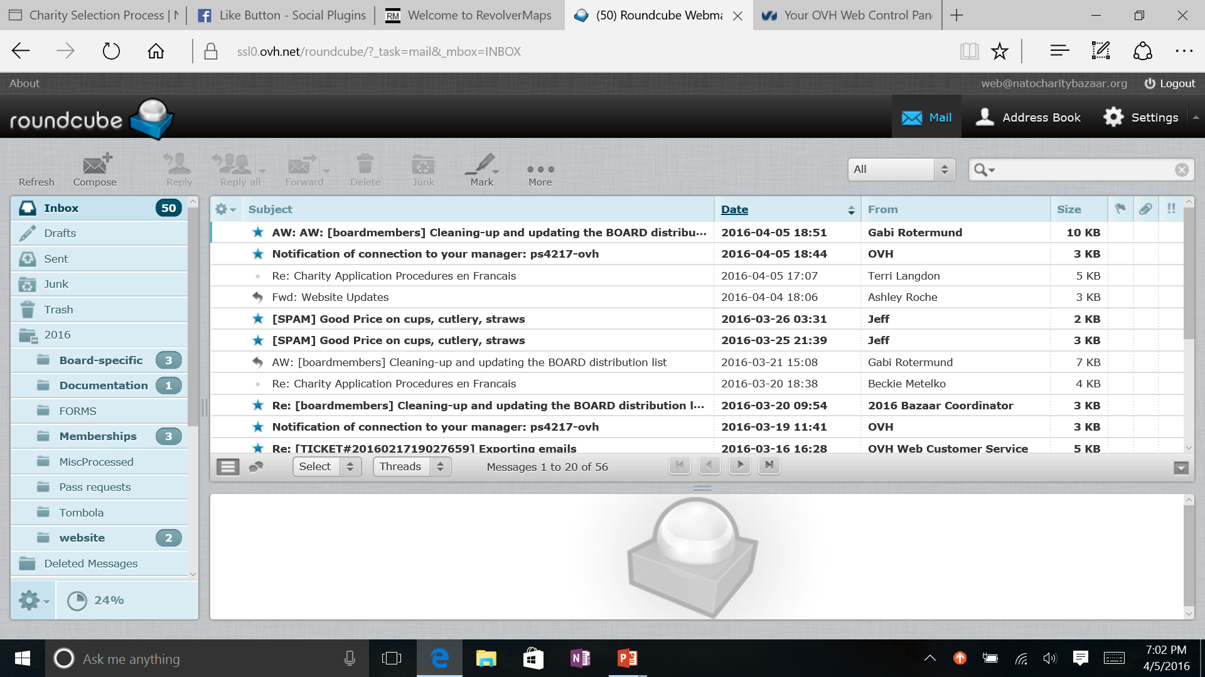
Updating Mailbox Information by Dale Maguire
Identify Yourself
Customizing what your recipients see when they see your message in their email box (from)
Determining email signature (if desired)
Determining blind cc option
Create ‘canned’ responses

Slide 2
Click the Settings icon on the command bar in the upper right corner of the Roundcube screen

Slide 3
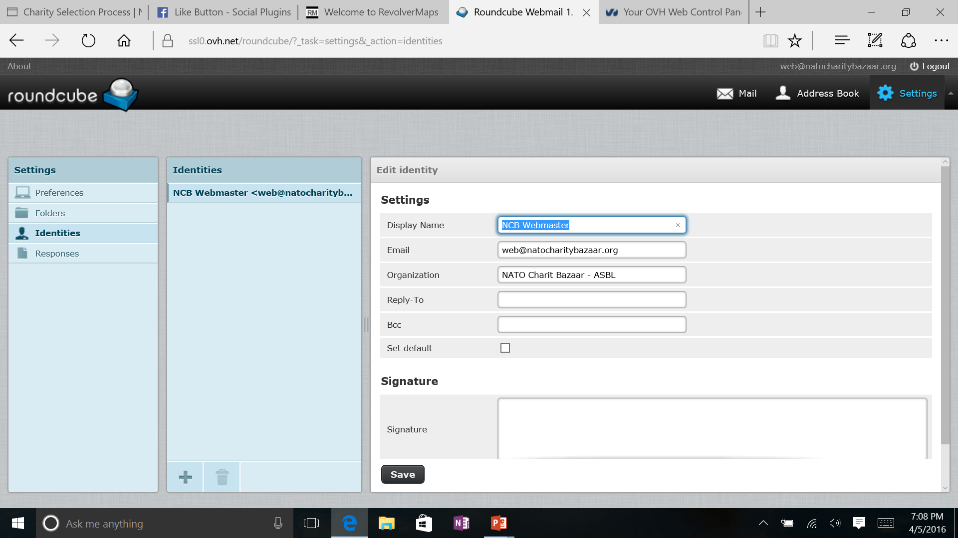
Identify yourself
Select ‘Identities’ from the Settings Menu
Click on the applicable identity from the list
Update the desired information such as
Display Name: the name you wish to display when people receive your emails
Signature: will be attached to all of your emails before sending
Bcc: a copy of all emails will be copied ‘blindly’ to the email address in this box. The recipient of the email will not know that this copy was sent
Click SAVE when satisfied

Slide 4
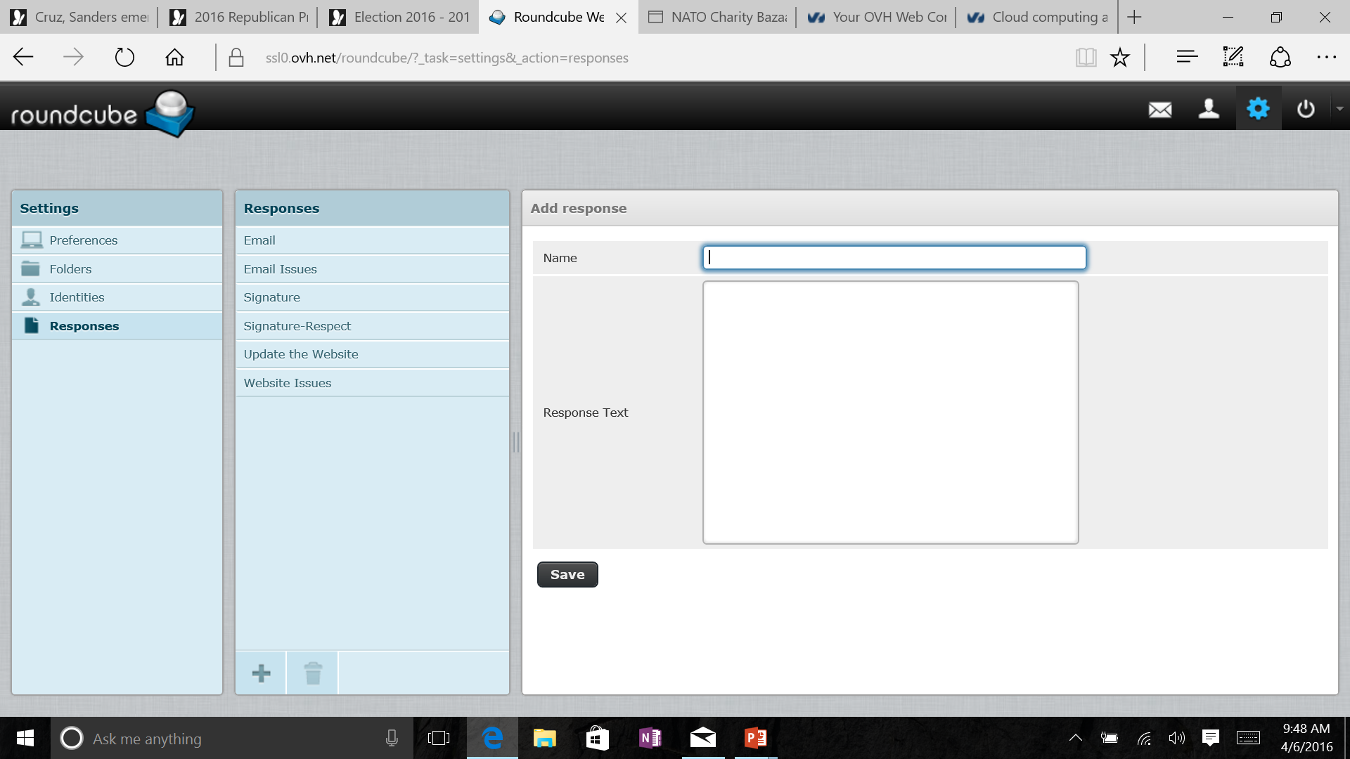
Setting-up ‘canned’ Responses
Once in Manage folders screen(see slide #2):
Select ‘Responses’ from Settings (left most) window menu
Click the ‘PLUS’ icon at the bottom of the Manage Folders Responses (middle) window
Create the desired response (Add response window):
Decide on a descriptive name for the response
Compose the response text
Click ‘Save’ once satisfied
The response created will be added to the list on the Responses menu
Previously created responses

Slide 5
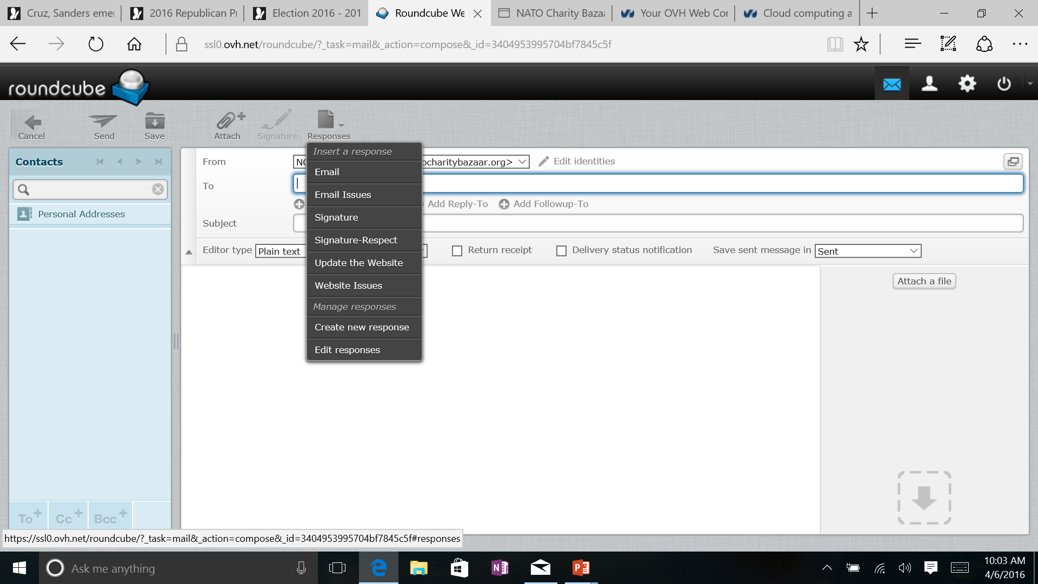
Using ‘canned’ Responses
Previously created responses may be used while creating new messages or responding to messages in your email box
Click the ‘Responses’ icon on the message command line
Select desired response from drop-down menu
The selected response text will be inserted in the message where the cursor is currently located OR at the bottom of the message if just opened, which may or may not require editing.

